Slide 1
Introduction to AI and Machine Learning

Slide 2
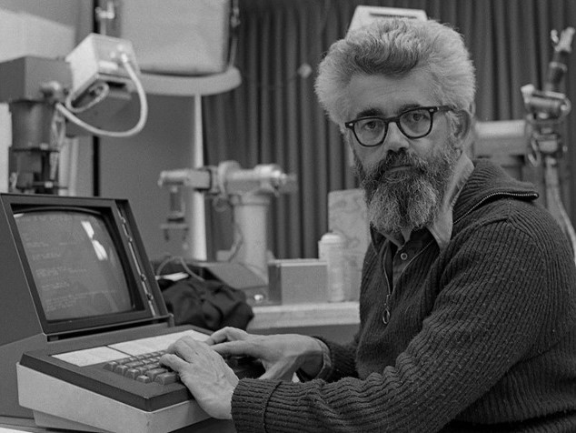
What is Artificial Intelligence ?
“The science and engineering of making intelligent machines, especially intelligent computer programs”.
John McCarthy

Slide 3
Four Phases of AI Research
Hybrid Architectures
Phase 4 –2010 -Present
Machine Learning
Phase 3 –1990 -2010
Knowledge Representation and Reasoning
Phase 2 –1970 -1990
Heuristic Search
Phase 1 –1950 -1970

Slide 4
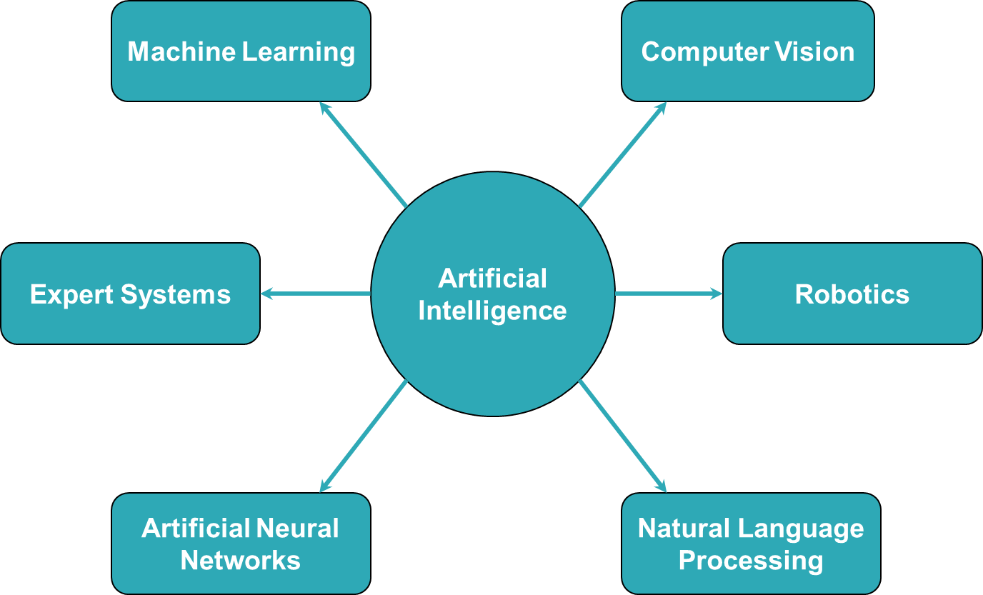
Branches of Artificial Intelligence

Slide 5
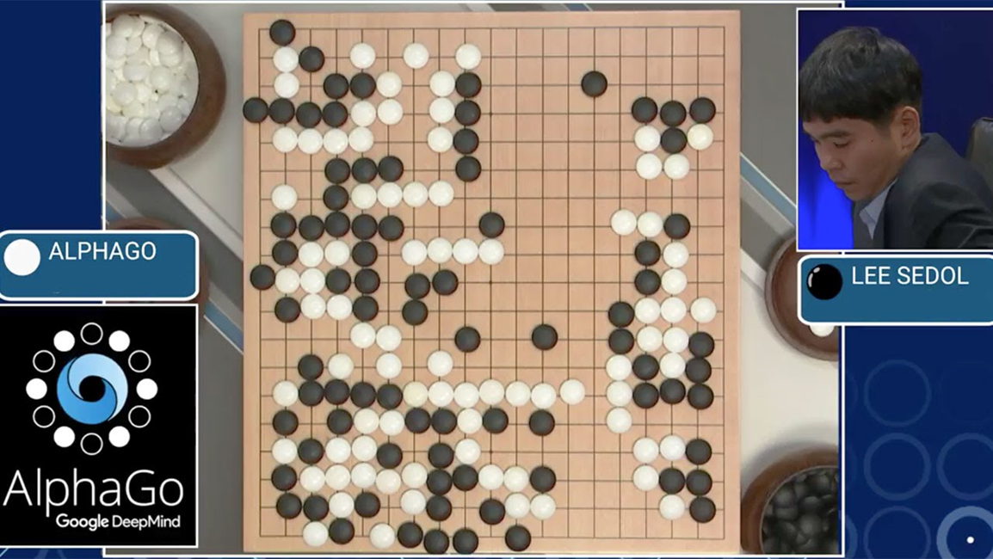
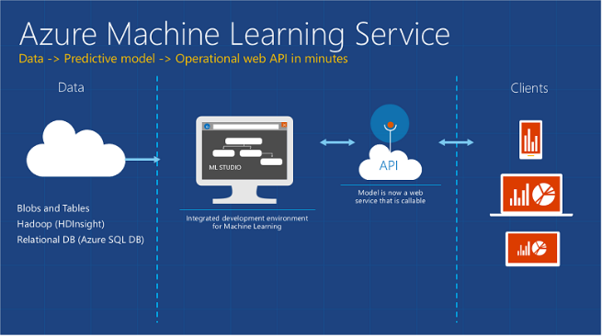
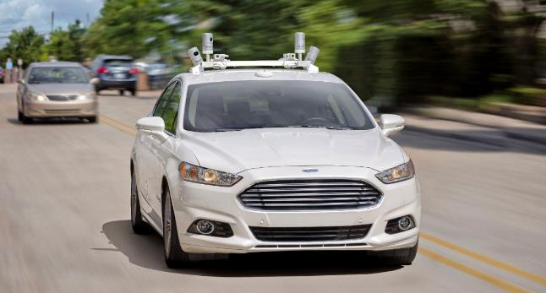

Applications of AI
Game Playing
Expert Systems
Chatbot
Personal Assistant
Data Analytics
Object Detection
Self-Driving Cars

Slide 6
Machine Learning

Slide 7
What is Machine Learning?
Subfield of artificial intelligence
Concerned with techniques that allow computers to “learn”.
Without being explicitly programmed.

Slide 8

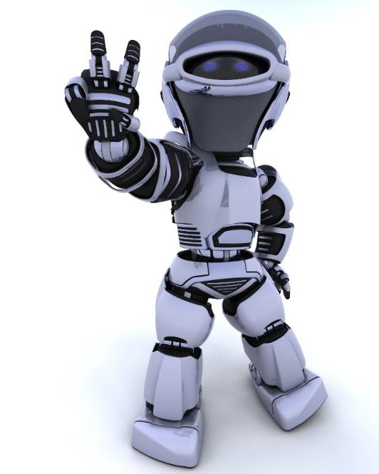

What is Machine Learning?
Data
Learn from experience
Learn from experience
Follow instructions

Slide 9
Types of Machine Learning
Machine Learning
Supervised Learning
Unsupervised Learning
Reinforcement Learning
Task driven (Regression / Classification)
Data driven
(Clustering)
Algorithm learns to react to an
environment

Slide 10
Supervised Learning Concept
Known Data Set
(Training Data)
Model
Predictions
A set of
Input data
Response values
Creates response values from input data.

Slide 11
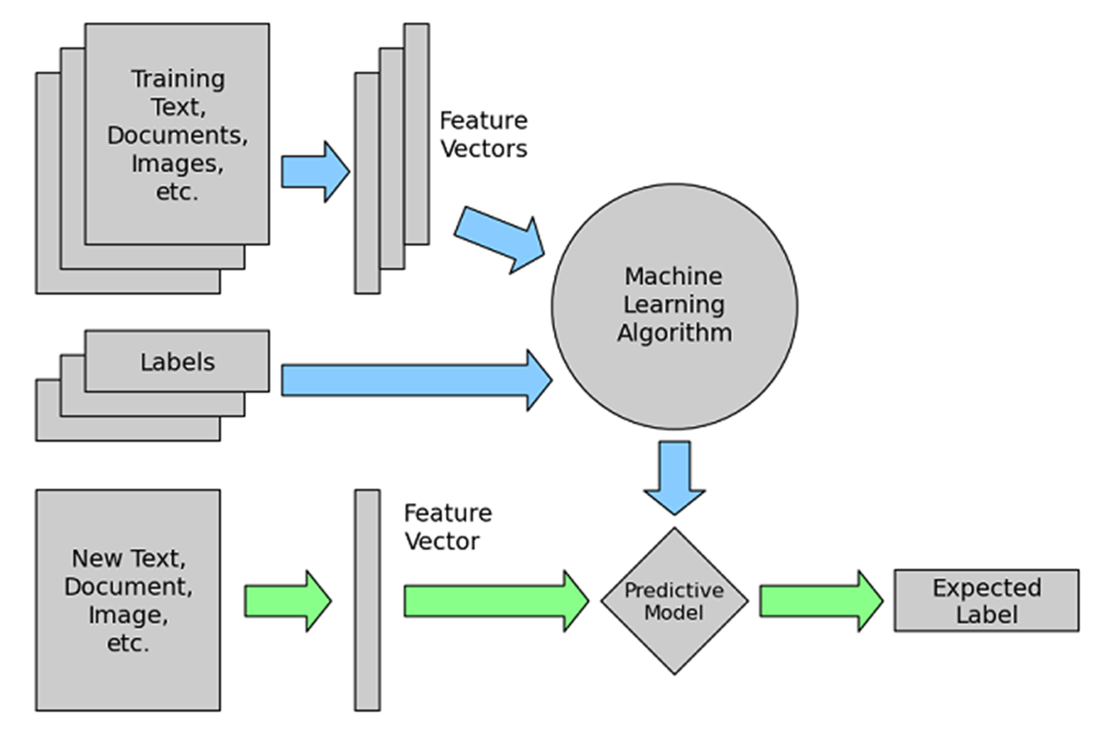
Detailed Concept

Slide 12
Types of Supervised Learning
Supervised learning can be separated into two general categories of algorithms:
Classification:
Categorical response values, where the data can be separated into specific “classes”
Regression
Continuous-response values

Slide 13
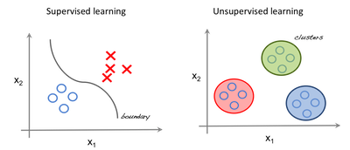
Unsupervised Learning
Operates on unlabeled examples.
Correct responses are not provided
The algorithm tries to identify similarities between the inputs
Inputs that have something in common are categorized together.
This is called clustering.

Slide 14
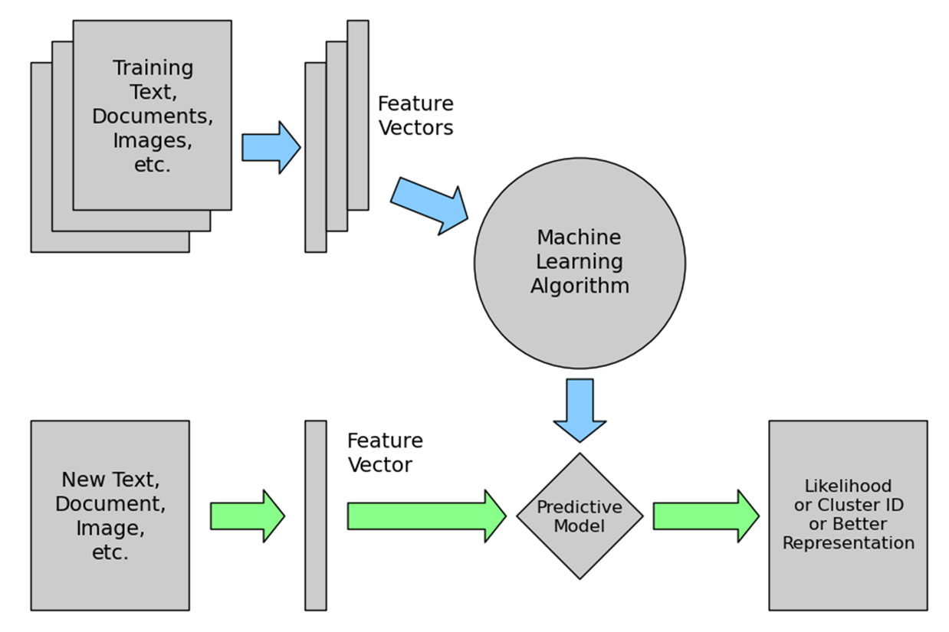
Unsupervised Learning

Slide 15
Reinforcement Learning
Type of ML that interacts with the environment
Learns which sequence of actions yields the most favorable results.
The learner is a decision-making agent that takes actions in an environment
Receives reward (or penalty) for its actions.
After a set of trial-and-error runs, it should learn the best policy
The sequence of actions that maximize the total reward.

Slide 16
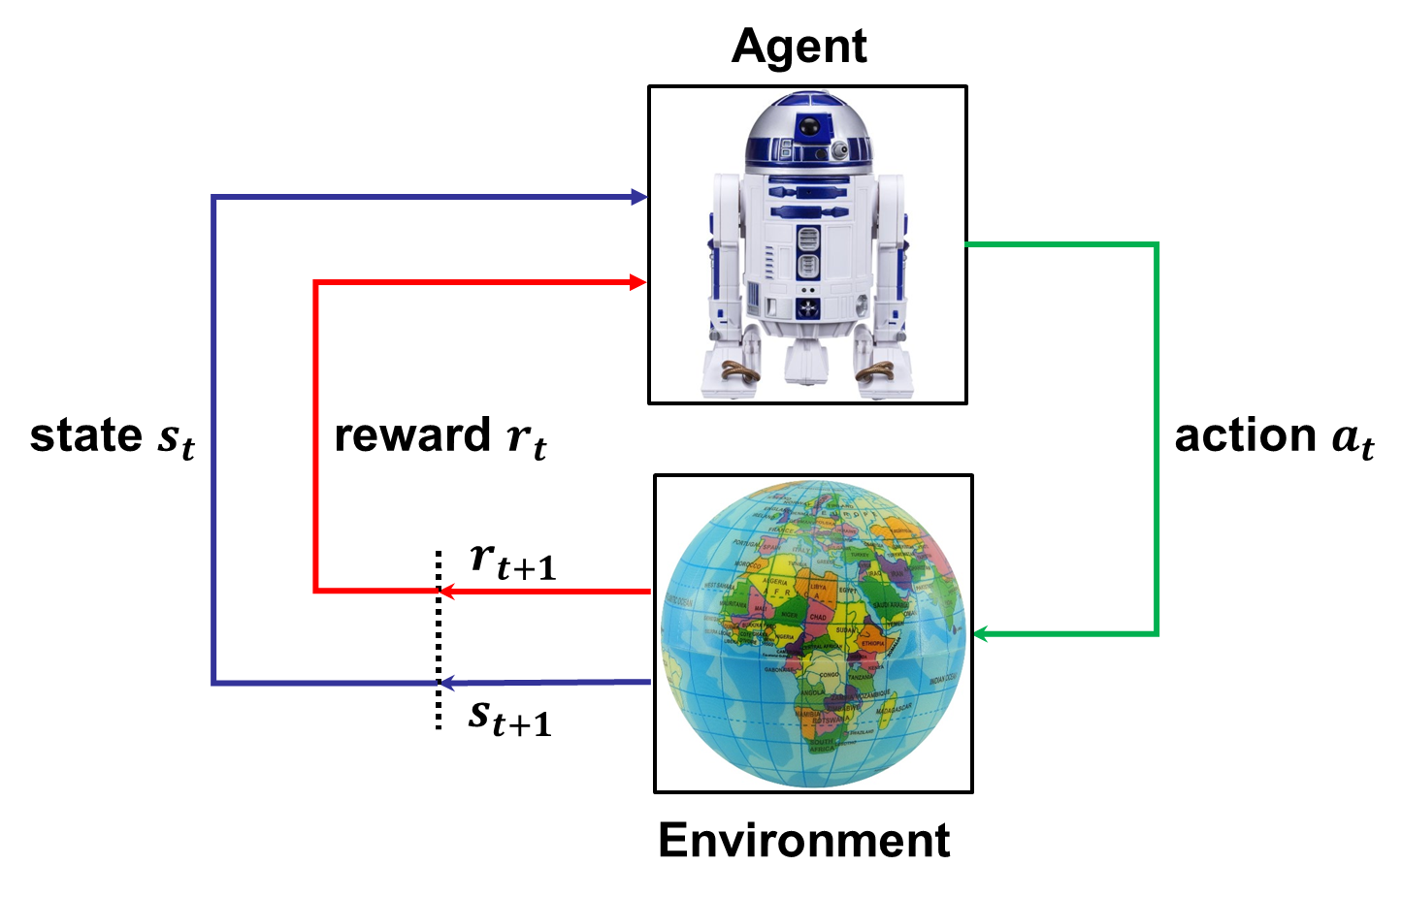
Reinforcement Learning

Slide 17
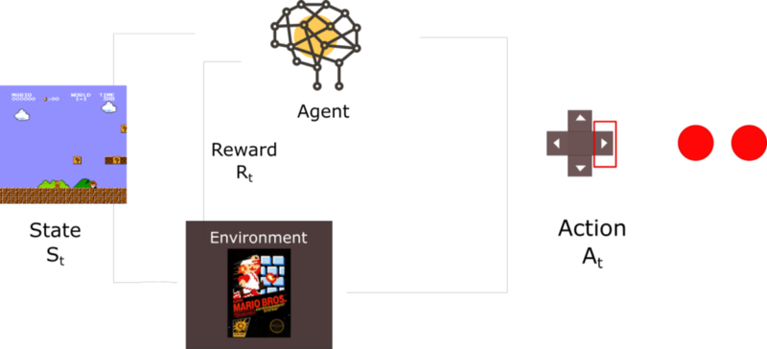
Mario Reinforcement Learning
https://youtu.be/qv6UVOQ0F44

Slide 18
Artificial Neural Network

Slide 19
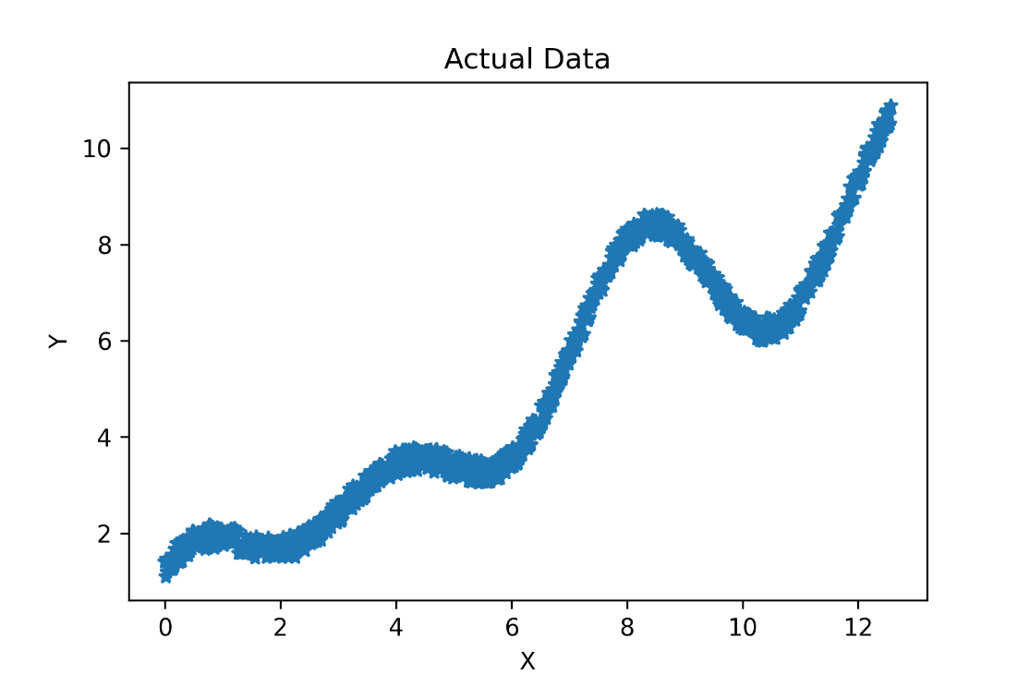
How do we fit a line to this data?

Slide 20
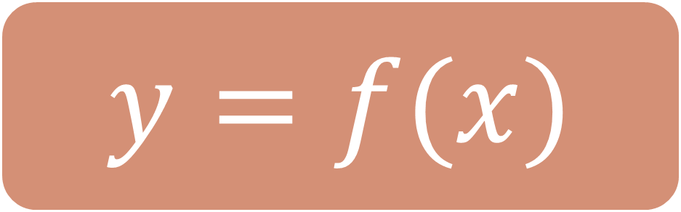
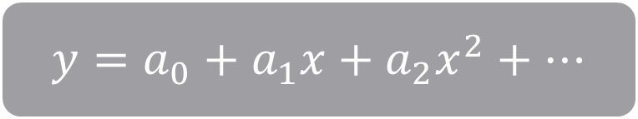
$$y=f(x)$$
$$y=a_{0}+a_{1}x+a_{2}x^{2}+…$$

Slide 21
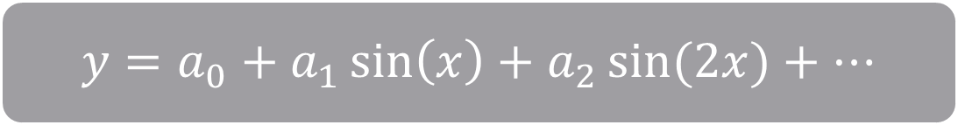
$$y=f(x)$$
$$y=a_{0}+a_{1}x+a_{2}x^{2}+…$$
$$y=a_{0}+a_{1}\sin\left(x\right)+a_{2}\sin{(2x)}+…$$

Slide 22

$$y=f(x)$$
$$y=a_{0}+a_{1}x+a_{2}x^{2}+…$$
$$y=a_{0}+a_{1}\sin\left(x\right)+a_{2}\sin{(2x)}+…$$
$$\text{Artificial} \text{Neural} \text{Network}$$
Universal Approximator

Slide 23

Artificial Neural Network

Slide 24
Artificial Neural Network
Regularization
Kernel Types
Optimization Technique
Activation Functions
Network Architecture

Slide 25
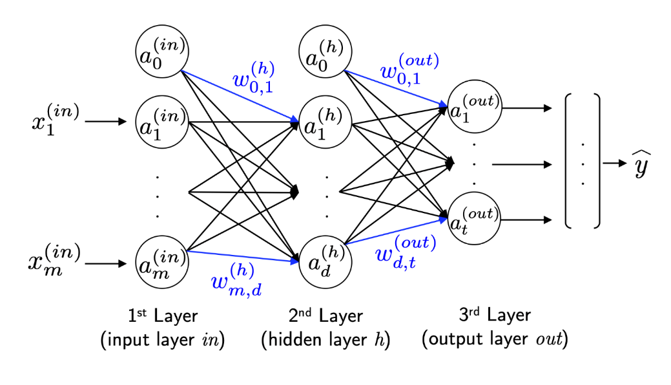
Connection to Biological Neural Networks
This connection is not relevant nowadays.

Slide 26
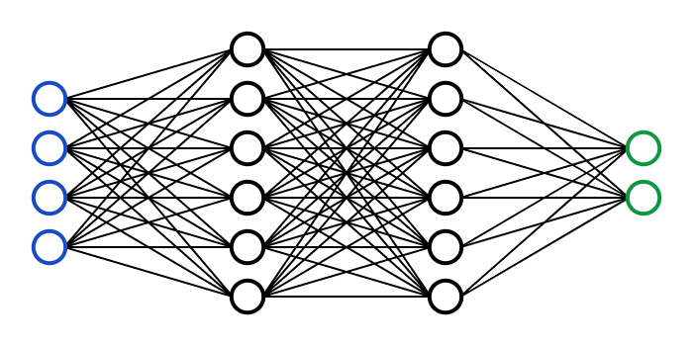
Architecture
Node
Input Layer
1st Hidden Layer
2nd Hidden Layer
Output Layer

Slide 27





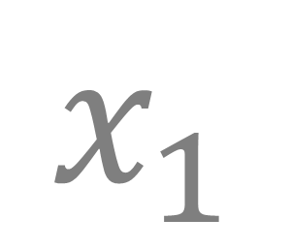
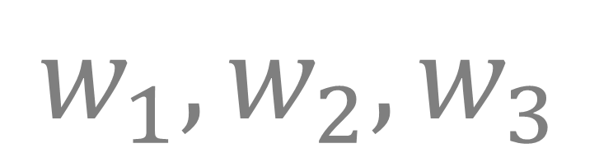
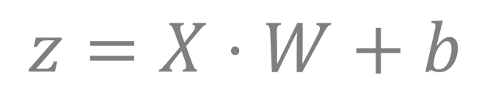

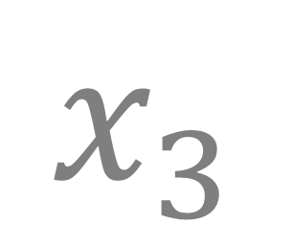

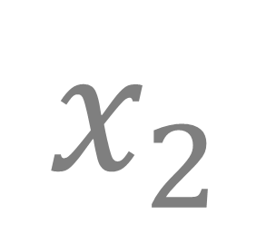

Hidden Node
$$w_{1},w_{2},w_{3}$$
$$b$$
Weights
Bias
$$φ$$
$$x_{1}$$
$$z$$
$$Σ$$
$$φ$$
$$φ$$
$$x_{2}$$
$$φ$$
$$x_{3}$$
Net Input Function
Activation Function
$$z=X⋅W+b$$
$$φ=φ(z)$$
Input
Output

Slide 28
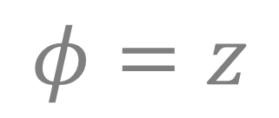
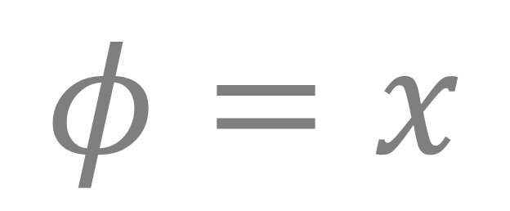
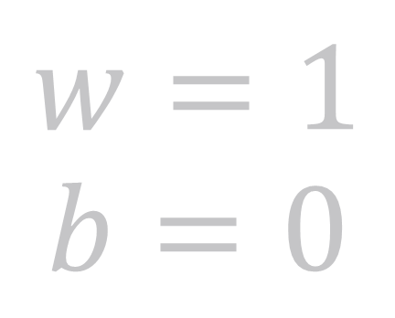


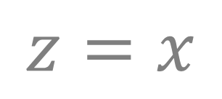
Input Node
$$w=1$$
$$b=0$$
$$z$$
$$x$$
$$Σ$$
$$φ$$
$$φ=x$$
Single Input
Single Output
Net Input Function
Activation Function
$$z=x$$
$$φ=z$$

Slide 29
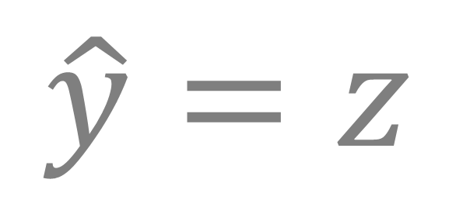
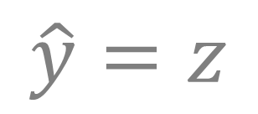
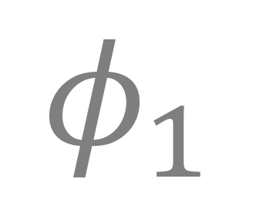
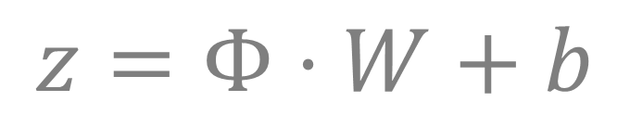
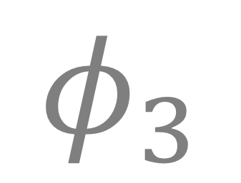

Output Node
$$w_{1},w_{2},w_{3}$$
$$b$$
Weights
Bias
$$φ_{1}$$
$$z$$
$$φ$$
$$\hat{y}=z$$
$$φ_{2}$$
$$Σ$$
Single Output
$$φ_{3}$$
Net Input Function
Activation Function
$$z=Φ⋅W+b$$
$$\hat{y}=z$$
Input

Slide 30
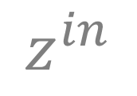
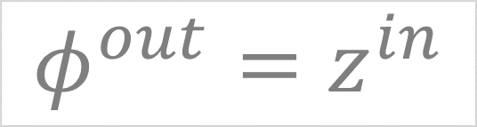

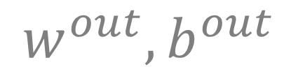
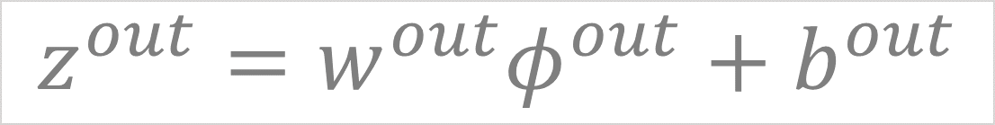


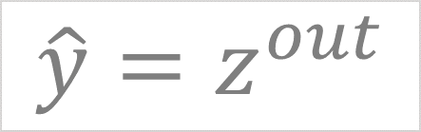


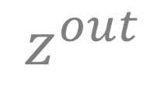

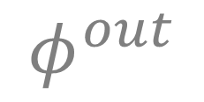
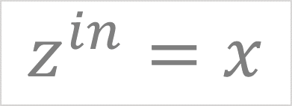
Input Layer
Output Layer
$$w^{out}, b^{out}$$
$$z^{in}$$
$$φ^{out}$$
$$z^{out}$$
$$x$$
$$Σ$$
$$φ$$
$$Σ$$
$$φ$$
$$\hat{y}$$
$$z^{in}=x$$
$$φ^{out}=z^{in}$$
$$z^{out}=w^{out}φ^{out}+b^{out}$$
$$\hat{y}=z^{out}$$
$$\hat{y}=w^{out}x+b^{out}$$

Slide 31
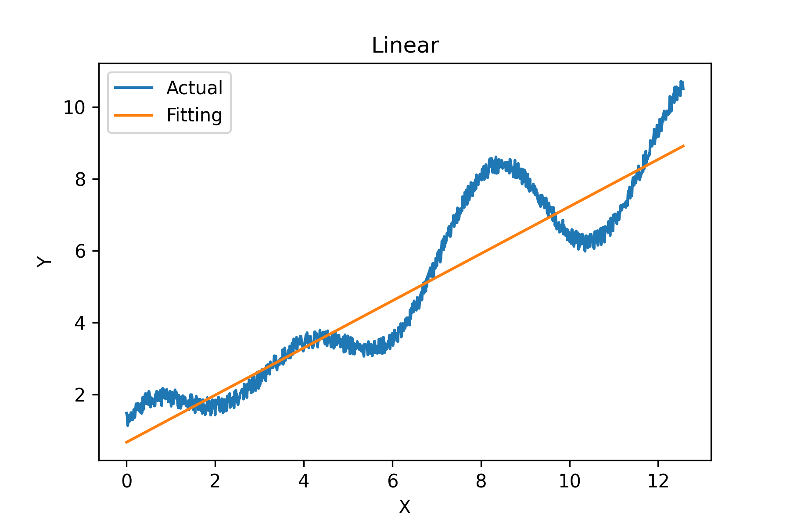
#Parameters: 2

Slide 32

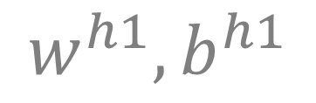
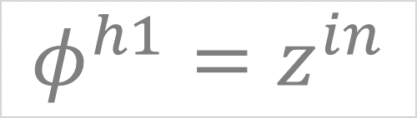

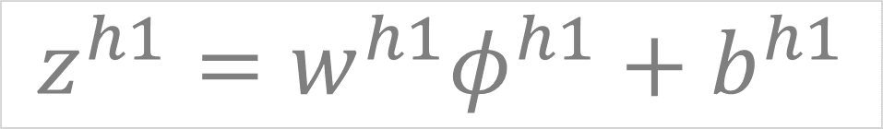





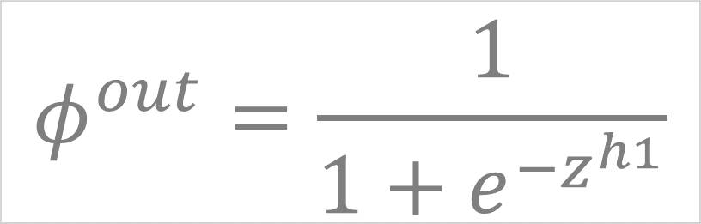



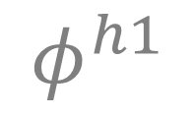




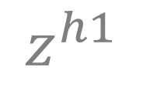
Input Layer
Hidden Layer
Output Layer
$$w^{h1}, b^{h1}$$
$$w^{out}, b^{out}$$
$$x$$
$$Σ$$
$$z^{in}$$
$$φ$$
$$φ^{h1}$$
$$Σ$$
$$z^{h1}$$
$$φ$$
$$φ^{out}$$
$$Σ$$
$$z^{out}$$
$$φ$$
$$\hat{y}$$
$$z^{in}=x$$
$$z^{h1}=w^{h1}φ^{h1}+b^{h1}$$
$$z^{out}=w^{out}φ^{out}+b^{out}$$
$$φ^{out}=\frac{1}{1+e^{−z^{h1}}}$$
$$\hat{y}=z^{out}$$
$$φ^{h1}=z^{in}$$
Sigmoid Function

Slide 33
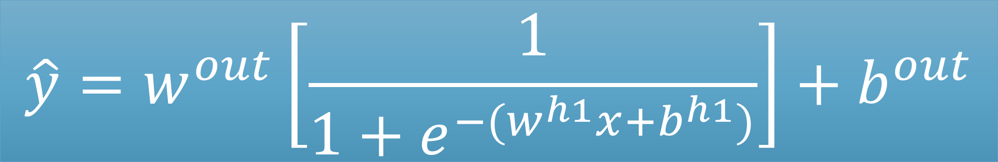
Input Layer
Hidden Layer
Output Layer
$$w^{h1}, b^{h1}$$
$$w^{out}, b^{out}$$
$$x$$
$$Σ$$
$$z^{in}$$
$$φ$$
$$φ^{h1}$$
$$Σ$$
$$z^{h1}$$
$$φ$$
$$φ^{out}$$
$$Σ$$
$$z^{out}$$
$$φ$$
$$\hat{y}$$
$$\hat{y}=w^{out}\left[\frac{1}{1+e^{−{(w}^{h1}x+b^{h1})}}\right]+b^{out}$$

Slide 34
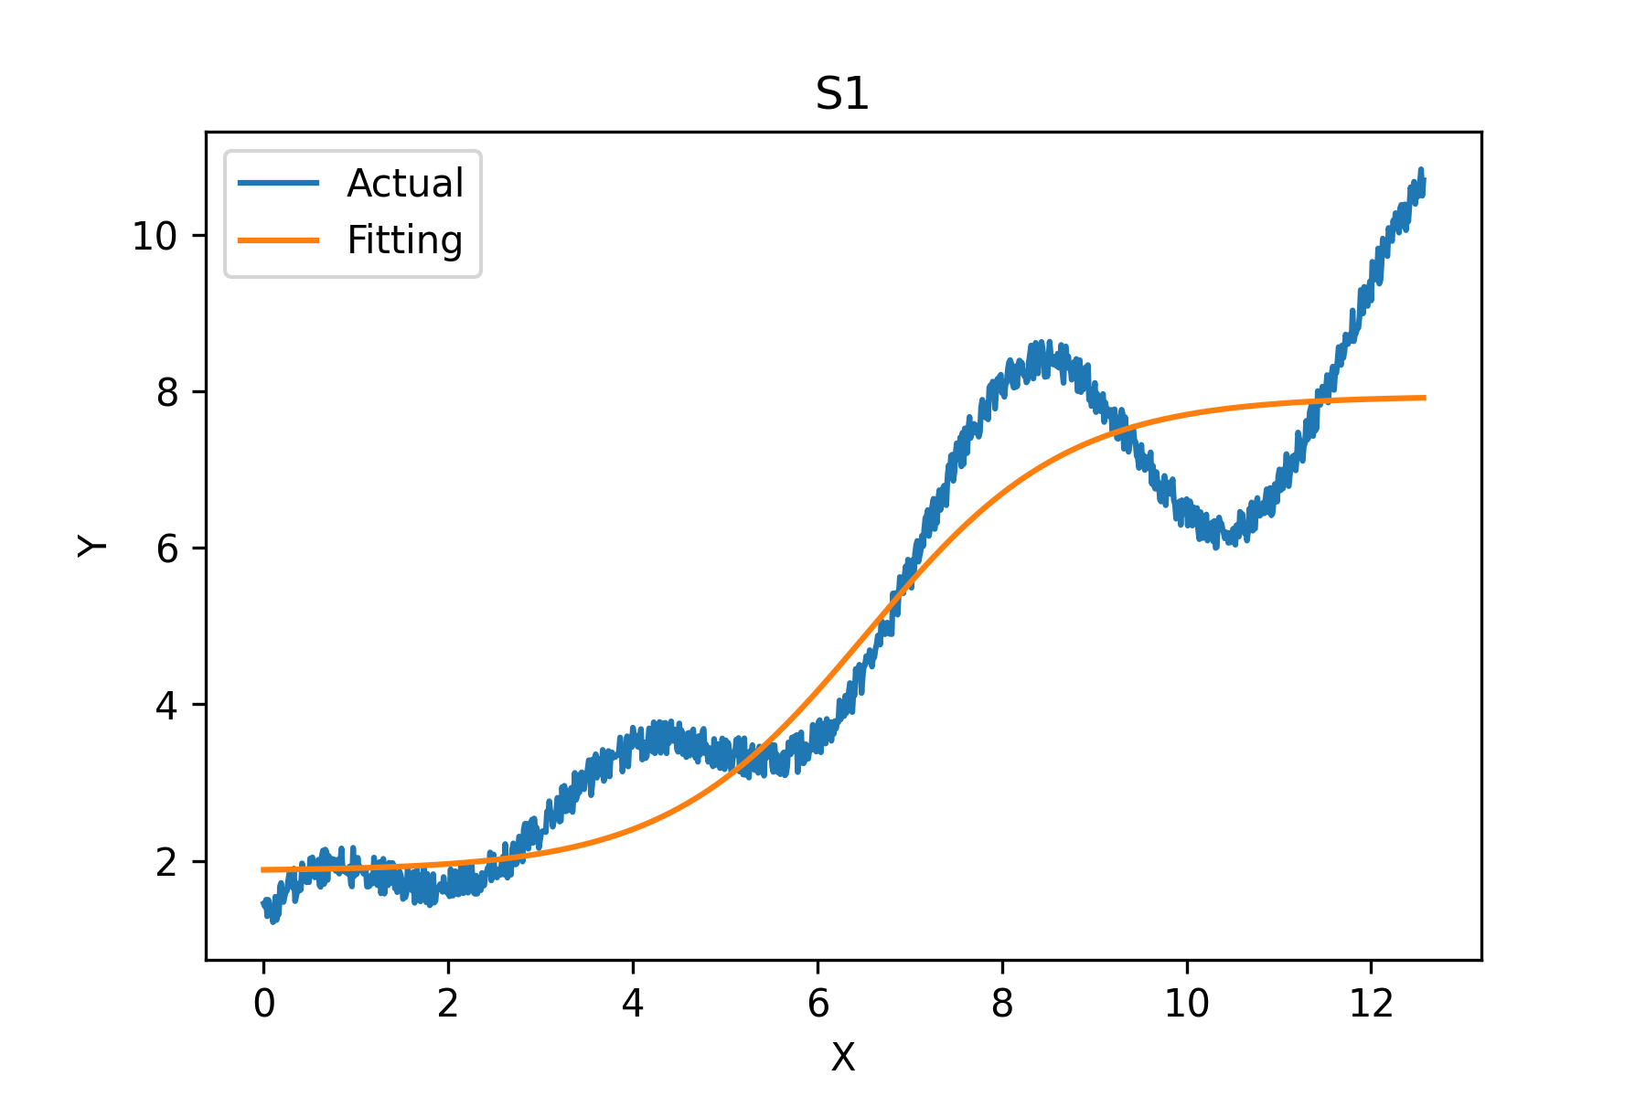
#Parameters: 4

Slide 35



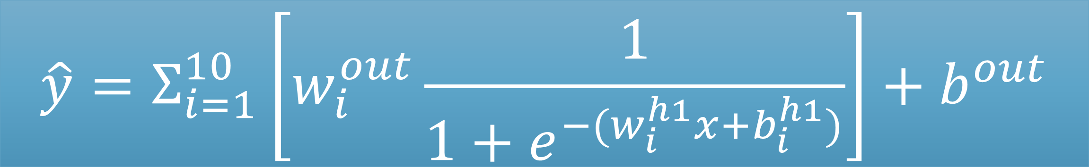
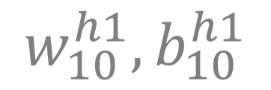


$$w_{1}^{h1}, b_{1}^{h1}$$
1
$$w_{2}^{h1}, b_{2}^{h1}$$
$$w_{1}^{out},w_{2}^{out}…,w_{10}^{out} , b^{out}$$
$$x$$
In
2
Out
$$\hat{y}$$
…
$$w_{10}^{h1}, b_{10}^{h1}$$
10
$$\hat{y}=Σ_{i=1}^{10}\left[w_{i}^{out}\frac{1}{1+e^{−{(w}_{i}^{h1}x+b_{i}^{h1})}}\right]+b^{out}$$

Slide 36

#Parameters: 31

Slide 37









$$w_{1}^{h1}, b_{1}^{h1}$$
$$w_{1,1}^{h2},w_{1,2}^{h2},…,w_{1,64}^{h2}, b_{1}^{h2}$$
1
1
$$w_{1}^{out},w_{2}^{out}…,w_{64}^{out} , b^{out}$$
$$w_{2}^{h1}, b_{2}^{h1}$$
$$w_{2,1}^{h2},w_{2,2}^{h2},…,w_{2,64}^{h2}, b_{1}^{h2}$$
In
2
2
Out
$$x$$
$$\hat{y}$$
…
…
$$w_{64}^{h1}, b_{64}^{h1}$$
$$w_{64,1}^{h2},w_{64,2}^{h2},…,w_{64,64}^{h2}, b_{1}^{h2}$$
64
64
128
4160
65
Parameters
Parameters
Parameters

Slide 38

#Parameters: 4,353

Slide 39


Deep Neural Network
256
256
128
64
In
32
Out
$$x$$
16
$$\hat{y}$$

Slide 40

#Parameters: 110,081

Slide 41
Types of DNN
Deep ANN
Data prediction
Convolutional neural network
Image
Recurrent neural network
Languages, audio
Transformer
Languages, audio

